Slide 1
NETWORKING CONCEPTS AND CYBER SECURITY
COMP40002
Introduction to the Linux OS

Slide 2
Learning Objectives
Overview about the operating systems
Introduction to the Linux OS
History of the Linux OS
Features of Linux OS
Various distros of Linux
Advantages of Linux over other OS

Slide 3
Introduction to the Operating Systems
What is an Operating System?
An operating system (OS) is a software program that serves as an intermediary between computer hardware and user applications. It manages the computer's hardware resources, provides common services for computer programs, and facilitates user interaction with the system.

Slide 4
Introduction to the Operating Systems
Key functions of an operating system include:
Resource Management: The OS allocates and manages system resources such as CPU time, memory space, disk space, and peripheral devices.
Process Management: It handles the execution of processes, including scheduling, multitasking, and synchronization between processes.
Memory Management: The OS controls the system's memory resources, allocating memory to processes as needed and managing memory swapping or paging to optimize performance.

Slide 5
Introduction to the Operating Systems
Key functions of an operating system include:
File System Management: It provides a way to organize and store files on storage devices such as hard drives, solid-state drives, and optical drives.
Device Management: The OS interacts with hardware devices such as keyboards, mice, printers, and network adapters, facilitating communication between software applications and hardware peripherals.
User Interface: Many operating systems provide a user interface (UI) that allows users to interact with the computer system, either through a graphical interface (GUI) or a command-line interface (CLI).

Slide 6
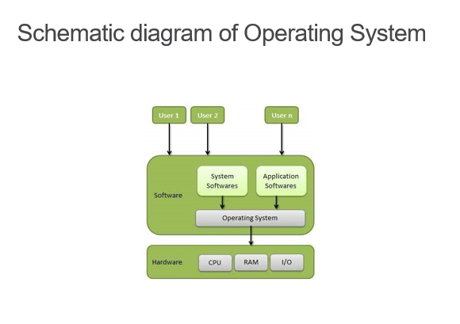
Introduction to the Operating Systems

Slide 7
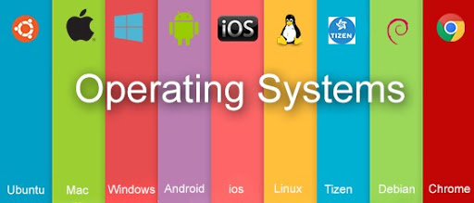
Introduction to the Operating Systems
Examples of Operating Systems
Microsoft Windows
  Including Windows Server
Unix-like systems
  Linux (Android, Chrome OS)
  macOS (iOS, iPadOS, tvOS, watchOS)
  BSD

Slide 8

Introduction to the Linux
What is Linux?
Unix-like computer operating system assembled under the model of free and open-source software development and distribution.
These operating systems share the Linux kernel.
○ Typically have the GNU utilities
Comes in several “distributions” to serve different purposes.

Slide 9
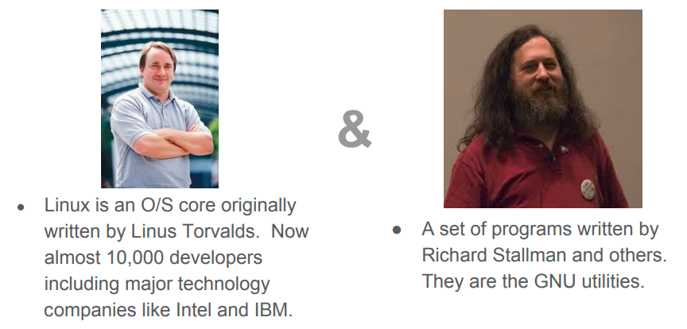
Introduction to the Linux
Who is Linux?

Slide 10
Introduction to the Linux
Where is Linux?
● World Wide Web
67% of the world’s web-servers run Linux (2016)
● Research/High-Performance Compute
Google, Amazon, NSA, 100% of TOP500 Super-computers.
● Modern Smartphones and devices
○ The Android phone
○ Amazon Kindle
○ Smart TVs/Devices

Slide 11
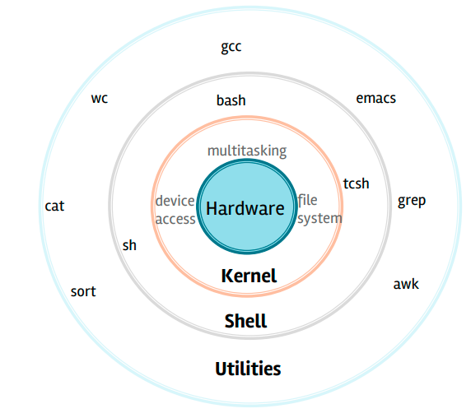
Architecture of the Linux OS

Slide 12
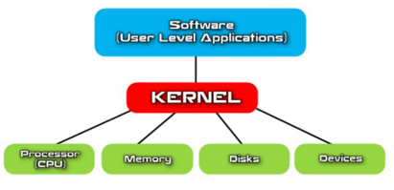
Architecture of the Linux OS
Linux Kernel
The Linux kernel is the main component of a Linux operating system (OS) and is the core interface between a computer’s hardware and its processes. It communicates between them, managing resources as efficiently as possible.

Slide 13
Architecture of the Linux OS
Linux Kernel
The kernel has 4 jobs:
Memory management: Keep track of how much memory is used to store what, and where
Process management: Determine which processes can use the central processing unit (CPU), when, and for how long
Device drivers: Act as mediator/interpreter between the hardware and processes
System calls and security: Receive requests for service from the process

Slide 14

Architecture of the Linux OS
GNU Packages
The Linux OS uses Linux Kernel along with the GNU packages.
GNU is an extensive collection of free software, which can be used as an operating system or can be used in parts with other operating systems

Slide 15
Architecture of the Linux OS
Major GNU Software used in Linux OS:
GNU Core Utilities (coreutils): These are basic, fundamental utilities for managing files and processes, including commands like ls, cp, mv, rm, mkdir, cat, grep, sed, awk, and many others.
GNU Compiler Collection (GCC): GCC is a collection of compilers for various programming languages, including C, C++, Objective-C, Fortran, Ada, and others. It's widely used for software development on Linux systems.

Slide 16
Architecture of the Linux OS
Major GNU Software used in Linux OS:
GNU C Library (glibc): glibc is the C library used in GNU/Linux systems. It provides the system calls and other low-level interfaces required by programs written in the C programming language.
GNU Bash (Bourne Again SHell): Bash is the default shell for most GNU/Linux distributions. It provides a command-line interface for interacting with the system and running commands, scripts, and programs.

Slide 17
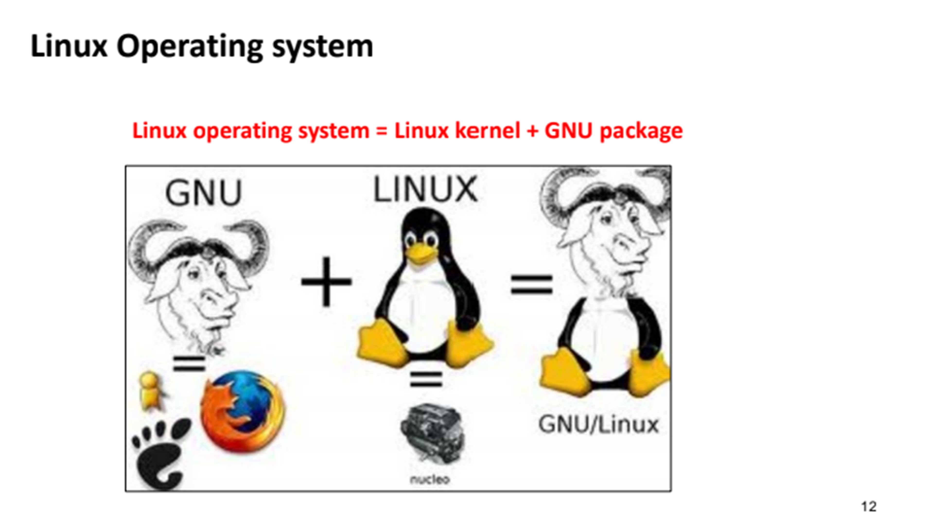
Architecture of the Linux OS

Slide 18
Features of the Linux OS
Hierarchical File System
Linux provides a standard file structure in which system files/ user files are arranged.
Multiprogramming
Linux is a multiprogramming system means multiple applications can run at same time.

Slide 19
Features of the Linux OS
Multi-Tasking
A program in Linux is broken down into tasks, each task is something like reading from or writing to the disk, or waiting for input from a user. The ability of any as to handle the execution of multiple tasks is known as multi-tasking.
Multi-User
Linux is a multiuser system means multiple users can access system resources like memory, ram, and application programs at same time.

Slide 20
Features of the Linux OS
Open Source
Linux source code is freely available and it is community based development project. Multiple teams’ works in collaboration to enhance the capability of Linux
operating system and it is continuously evolving.

Slide 21
Advantages of the Linux OS
Advantages of Linux over other OS:
Open Source: Linux is distributed under open-source licenses, which means its source code is freely available for anyone to view, modify, and distribute. This fosters collaboration, innovation, and transparency within the community.
Cost-Effective: Linux is typically free to download and use, which can lead to significant cost savings for individuals, businesses, educational institutions, and government agencies. Additionally, Linux-based software applications and tools are often available at no cost or at a lower cost compared to proprietary alternatives.

Slide 22
Advantages of the Linux OS
Stability and Reliability: Linux is known for its stability and reliability, with many distributions offering long-term support (LTS) releases that receive updates and security patches for several years. This makes Linux suitable for mission-critical applications and systems where uptime is crucial.
Security: Linux provides robust security features, including user permissions, access control lists (ACLs), file encryption, firewalls, and mandatory access controls (MAC) like SELinux and AppArmor. Regular security updates are released to address vulnerabilities and protect against security threats.

Slide 23
Advantages of the Linux OS
Customizability: Linux distributions can be highly customized to meet specific user preferences and requirements. Users can choose from a variety of desktop environments, window managers, themes, and software packages to create a personalized computing environment tailored to their needs.
Performance: Linux is known for its performance optimization and efficiency, particularly in server and embedded environments. The Linux kernel is designed to make efficient use of system resources, resulting in faster boot times, reduced memory usage, and improved overall system responsiveness.

Slide 24
Advantages of the Linux OS
Scalability: Linux scales well from small embedded devices to large-scale server clusters. It can handle a wide range of workloads, from simple tasks to complex computations, making it suitable for use in various computing environments, including IoT devices, desktop computers, servers, and supercomputers.
Compatibility: Linux supports a wide range of hardware architectures and peripherals, making it compatible with diverse hardware configurations. It also provides compatibility layers and virtualization technologies (such as Wine and virtual machines) to run software designed for other operating systems.

Slide 25
Advantages of the Linux OS
Community Support: Linux has a vibrant and active community of users, developers, and contributors who provide support, documentation, forums, and online resources. This community-driven ecosystem helps users troubleshoot issues, share knowledge, and collaborate on software development.
Freedom: Linux empowers users with freedom and control over their computing experience. Users are not locked into proprietary software ecosystems, and they have the flexibility to customize, modify, and redistribute Linux-based software according to their preferences and needs.

Slide 26
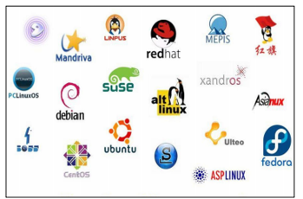
Distros of Linux
A Linux distribution, often abbreviated as "distro," is a complete operating system built on top of the Linux kernel along with various software packages and tools from the GNU Project and other open-source projects.
While the Linux kernel serves as the core component of all Linux distributions, each distribution packages different sets of software, utilities, and configurations to create a unique user experience and cater to specific use cases and preferences.

Slide 27

Distros of Linux
Debian –
Pros:
Extremely stable and reliable
Large software repository
Wide range of hardware support
Offers multiple desktop environments
Advanced package management system
Cons:
Not as beginner-friendly
Slower release cycle than some other distros
Can be difficult to install some software packages

Slide 28

Distros of Linux
Ubuntu –
Pros:
Easy to install and use
Large and active community for support
Huge software repository
Regular security updates
Many variants with different desktop environments
Cons:
Can be resource-intensive
Some may find it too “bloated”
Not as customizable as some other distros

Slide 29

Distros of Linux
OpenSUSE –
Pros:
Stable and reliable
Good for enterprise use
Wide range of desktop environments
Comprehensive configuration tool
Good community support
Cons:
Not as up-to-date as other distros
Can be resource-intensive
Limited software repository.

Slide 30

Distros of Linux
CentOS –
Pros:
Stable and reliable
Long-term support
Strong security features
Good for server use
Great for enterprise use
Cons:
Not as updated as other distros
Not as beginner-friendly
Limited software packages

Slide 31

Distros of Linux
Fedora –
Pros:
Cutting-edge features and software packages
Regular software updates
Wide range of desktop environments
Good support for developers
Cons:
Can be unstable due to the latest software
Not as beginner-friendly
Short support period

Slide 32

Distros of Linux
Linux Mint –
Pros:
Beginner-friendly
Familiar interface for Windows users
Wide range of desktop environments
Good for general use
Stable and reliable
Cons:
Not as up-to-date as other distros
Limited software repository
Can be resource-intensive

Slide 33

Distros of Linux
Kali Linux –
Pros:
Comprehensive set of security tools
Great for penetration testing and digital forensics
Wide range of hardware support
Constantly updated
Good community support
Cons:
Not suitable for general use
Can be complex to use
Requires specific knowledge and experience

Slide 34
Question and Answer Session
Q & A

